Slide 1
Empirical Comparison of Machine Learning Models for Band Gap Prediction
Guide: Dr. S kumaran
Anantha Natarajan s 112112008
Ezhilvel me 112112019
Varadhan r 112112042

Slide 2
Abstract
Exploring novel machine learning approaches to predict band gaps of binary compounds using their known physical features.
Various models are developed, discussing their respective performances, advantages, shortcomings and flaws.
We also analyze different combination of features and their impact on the prediction.

Slide 3
Intro to Machine Learning
It’s a field of study that gives computers the ability to learn without being explicitly programmed.
Machine learning explores the study and construction of algorithms that can learn from and make predictions on data.
Such algorithms operate by building a model from example inputs in order to make data-driven predictions or decisions expressed as outputs, rather than following strictly static program instructions.
The 3 types of machine learning are: supervised, unsupervised and reinforcement learning.

Slide 4
SCHEMATIC BLOCK DIAGRAM

Slide 5
Data Collection
The data regarding the binary system and its bandage energy is obtained from an REST API of https://materialsproject.org.
The obtained subset data has 4096 rows of different binary systems. The data of binary compound systems and its band gap energy is collected in a csv format for further processing and usage.
To derive these features from a single binary compound, Pymatgen is used. Pymatgen (Python Materials Genomics) is a robust, open-source Python library for materials analysis.

Slide 6
Preprocessing
Formatting: Formatting represents the way the data is stored either in a database or a local readable repository/file. The data is stored in a convenient way for easier I/O processing. Python’s numpy is used to read the csv data file for analysis and processing.
Data transformation: The binary compound system is transformed into various features that depicts the model. The following are the features that are considered:
● Electronegativity difference of elements in binary compound
● Atomic fractions of elements in binary compound
● Position of elements of binary compounds in periodic table
● Atomic number of elements in binary compound

Slide 7
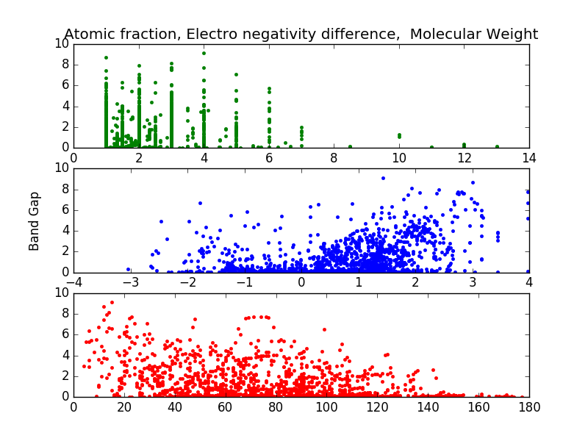
Graphs

Slide 8
Linear Regression
The MAE of the linear ridge using the naive features: 0.583 eV

Slide 9
Bucketization
The purpose of integrating bucketization into the machine learning models is to convert the regression into a classification problem.
The attribute bucketized is the band gap energy of binary compound system. The apparent sensitive value of each bucket it set to 0.25 eV. 40 buckets, each size of 0.25eV is generated across ranges of band gap energy.
This process would consequently reduce the Mean Absolute error (MAE) produced by regression models. This way of classification with bucketization will increase the accuracy of the built model.

Slide 10
Classification - SVM
Accuracy using SVM is : 71.1673699015%

Slide 11
Random Forrest
Accuracy using Random Forest is: 91.4233576642%

Slide 12
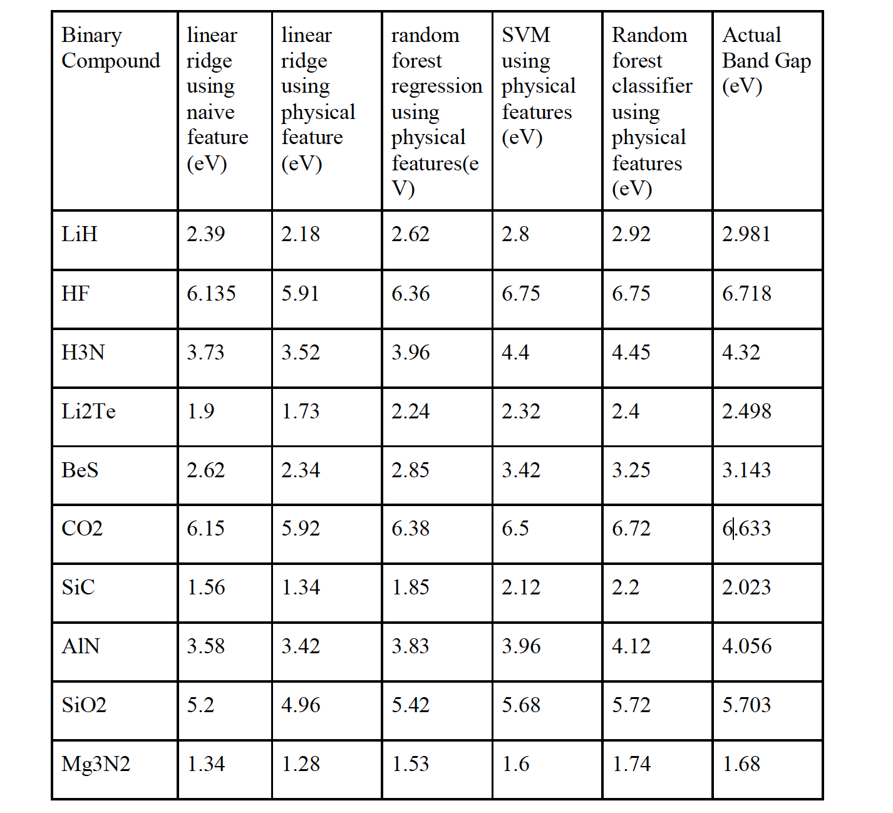
RESULTS

Slide 13
Conclusion
A 92% accuracy of 0.25 eV ranges is a huge advancement compared to ongoing research in this field which present a 0.5 eV error with multiple assumptions.
From here, the two main levers we have to further enhance our model are: adding more training data and further feature engineering.

